Slide 1
Literature Review

Slide 2
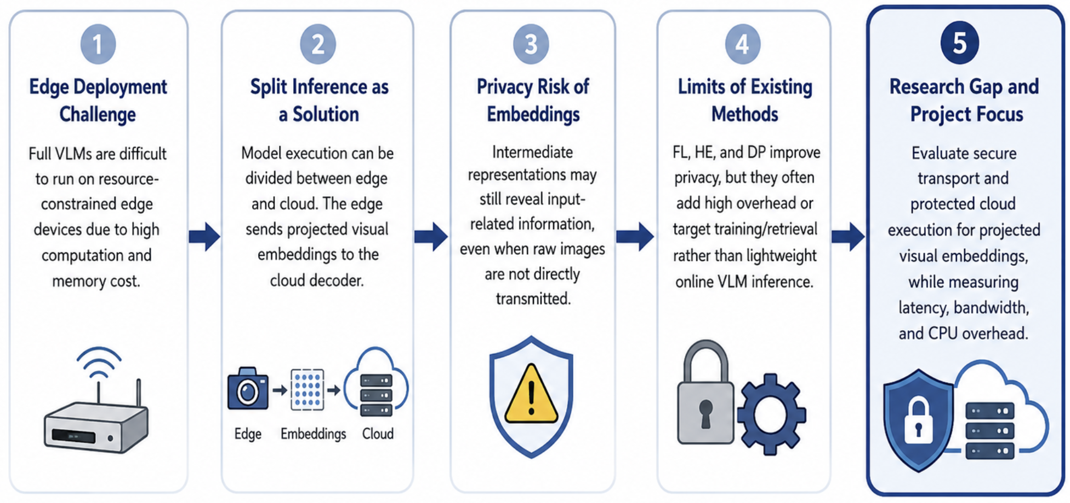
Literature Review Logic and Research Gap
The key gap is how to protect intermediate embedding in split VLM inference.
Notes:
This slide explains the logic of the literature review and the research gap of this project.
First, full vision-language models are difficult to deploy on resource-constrained edge devices. They require high computational power and memory, which are often not available on devices such as mobile or IoT platforms.

Slide 3
Related work - 1
Theme | Representative Papers | Main Findings and Limitations | Relate to topic
Edge Deployment of Vision–Language Models | VLM edge deployment survey; MobileVLM; EdgeVL | Lightweight architectures, efficient projectors, knowledge distillation, and quantisation can reduce the computational and memory demands of VLMs on resource-constrained devices. However, distillation and quantisation-aware training add training and engineering complexity, while model compression may reduce capability on complex vision–language tasks. Consequently, fully deploying capable VLMs on highly constrained edge devices remains challenging. | Motivates splitting the VLM pipeline between edge and cloud, while high lighting the need to protect data generated at the split point.

Slide 4
Related work - 2
Theme | Representative Papers | Main Findings and Limitations | Relate to topic
Split Inference and Dis- tributed VLM Architec- tures | Neurosurgeon; distributed VLM architecture | Split inference partitions model execution between edge and cloud resources. Recent distributed VLM work sends projected visual embeddings from an edge-side visual encoder and projection module to a cloud-side language decoder. The split point affects communication cost, local computation, cloud computation, and end-to-end latency. | Provides the technical basis for the implemented pipeline, in which projected visual embeddings are generated at the edge and reconstructed for cloud-side VLM decoding.

Slide 5
Related work - 3
Theme | Representative Papers | Main Findings and Limitations | Relate to topic
Privacy Risks of Intermediate Representations | UnSplit; Feature-Oriented Reconstruction Attack (Both assume an honest-but-curious) | Intermediate representations (smashed data) can reveal information about client inputs under particular split-learning threat models. Honest-but-curious servers may use received representations and knowledge of the client-side model to reconstruct inputrelated information. | Supports the security motivation of the project: projected visual embed- dings should not automatically be treated as non-sensitive data, even when raw images are not directly transmitted.
Privacy-Preserving and Secure Inference Methods (signal Methods) | Federated Learning FedAGRU; client selection; Homomorphic Encryption: ENCRYPTION-FRIENDLY LLM ARCHITECTURE Differential Privacy; | FL mainly protects training data by keeping it on local clients, while HE enables encrypted computation at substantial computational cost. DP provides formal privacy guarantees through controlled noise addition, which may reduce utility. | Directly informs the proposed system, which evaluates protected embedding transmission and hardware-backed protection for cloud-side processing.
Notes:
If transport encryption is compromised, an attacker may obtain the intermediate embeddings. To perform feature inversion, the attacker usually needs knowledge of the encoder, access to the encoder, or sufficient auxiliary data to train a substitute model.
On the other hand, an attacker can use embedding–image pairs to learn an approximate inverse mapping from embeddings to input images. To generate a large number of such pairs independently, the attacker needs knowledge of the encoder or access to an embedding-generation service.

Slide 6
Related work - 4
Theme | Representative Papers | Main Findings and Limitations | Relate to topic
Privacy-Preserving and Secure Inference Methods (Combined Methods) | Privacy-preserving multimodal retrieval: PMIRS | Combined multimodal designs can use FL， feature obfuscation and encryption method, but may focus on retrieval or training rather than online VLM inference. Main idea: federated learning is used to train or fine-tune a shared global model, while split learning divides the model between edge devices and the cloud during inference. | Supports the security motivation of the project: projected visual embeddings should not automatically be treated as non-sensitive data, even when raw images are not directly transmitted.
Secure Transport and Protected Cloud Execution | ChaCha20-Poly1305; confidential computing: SecMdp, DarkneTZ | Authenticated encryption can protect embedding confidentiality and integrity during network transmission. Trusted execution environments can isolate selected data and model components during execution. However, protected execution introduces deployment, compatibility, and runtime-overhead considerations | Directly informs the proposed system, which evaluates protected embedding transmission and hardware-backed protection for cloud-side processing.

Slide 7
Threat Model
Trusted and untrusted components
Trusted:
Edge device and its local VLM visual encoder/projector
Input image before transmission
Cryptographic implementation
Trusted execution environment used for cloud-side decoding
Potentially untrusted:
Public network between edge and cloud
Cloud operating system, hypervisor, and infrastructure administrator
External attacker able to observe or interfere with network traffic
LLM decoder is trusted only when it runs inside the confidential-computing environment.
Main attacker
An active network attacker
eavesdrop on embedding packets (Confidentiality)
modify, drop, delay, replay, or inject packets; (Integrity)
attempt a man-in-the-middle attack; (Confidentiality, Integrity)
impersonate the edge or cloud endpoint if authentication is absent.
A privileged cloud-side attacker
compromised host OS tries to read process memory.
Process debugging or injection
Logging leakage
Storage leakage
Out of scope:
Hardware vulnerabilities, TEE side-channel attacks, physical attacks, denial-of-service attacks
Compromise of the edge device

Slide 8
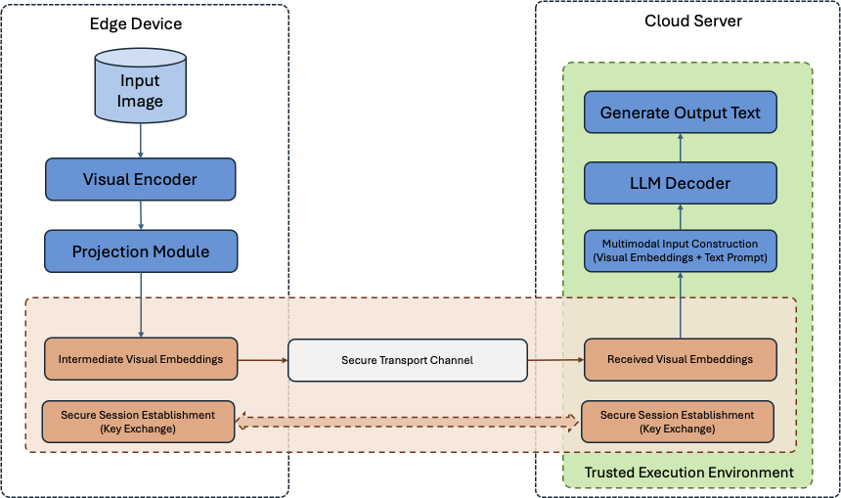
METHODOLOGY
The design is informed by distributed VLM architectures, secure edge-cloud communication, and confidential computing.
The system uses an edge-cloud split-inference pipeline for VLM inference.
The edge device processes the input image using the visual encoder and projection module.
The resulting intermediate visual embeddings are serialised and securely transmitted to the cloud.
The cloud combines the received embeddings with the processed text prompt to form the multimodal input. The LLM decoder generates the final text output inside a trusted environment.

Slide 9
Initial Ideas
QUIC TLS 1.3 (UDP, reduce latency, Encryption Algorithm, Key exchange)
DataSet: HuggingFaceM4 /the_cauldron AI2D subset
Model: nanoVLM
Encryption: ChaChao20-Poly1305 vs AES-GCM
TEE: Intel TDX

Slide 10
MobileVLM
MobileVLM is an efficiency-oriented VLM. Its goal is to make a vision-language model run locally on mobile/edge hardware by reducing the language-model size and, especially, reducing the number of visual tokens sent into the LLM.
Main pipeline:
Image -> CLIP ViT-L/14 visual encoder (576 visual tokens) LDP: Lightweight Downsample Projector (144 visual tokens) -> MobileLLaMA (1.4B or 2.7B) -> Generated text answer
key contribution: LDP (Lightweight Downsample Projector)

Slide 11
EdgeVL
MobileVLM is an efficiency-oriented VLM. Its goal is to make a vision-language model run locally on mobile/edge hardware by reducing the language-model size and, especially, reducing the number of visual tokens sent into the LLM.
Main pipeline:
Image -> CLIP ViT-L/14 visual encoder (576 visual tokens) LDP: Lightweight Downsample Projector (144 visual tokens) -> MobileLLaMA (1.4B or 2.7B) -> Generated text answer
key contribution: LDP (Lightweight Downsample Projector)

Slide 12
A privacy-preserving multi-user retrieval system for multimodal artificial intelligence - 1
What problem?
Main Framework: distributed edge nodes + cloud-based AI applications.
Edge-side: User image / text -> Encoder -> Embedding
Cloud–side: Cloud retrieval / matching -> Return relevant image/text result
Context: Raw image, text, or embedding may contain private information.
Used for: medical image retrieval, privacy-conscious customer service bots.
What method (Main Idea)?
Present PMIRS, a system Combinates obfuscation techniques (block-wise projection), encrypted inference (AES + CBC 128-bit keys), secure key management (Diffie-Hellman) + federated learning.
In the training phase, using Federated learning for Privacy-Preserving Training, which improves the F1-score and precision of the model without user-sensitive data. In the inference phase, combining obfuscation techniques, encrypted techniques (AES + CBC) and DH for secure key management.

Slide 13
A privacy-preserving multi-user retrieval system for multimodal artificial intelligence - 2
Threat Model: The threat model assumes that the cloud server is not fully trusted.
Framework Design:
Component Selection:
A lightweight model based on the CLIP codebase. (Pre-trained model and fine-tuned)
Encryption Algorithm : AES-CBC 128 bits,
Fine-tuning method: Federated Learning (Upload weights with AES Encryption)
Evaluation:
Simulated cloud-based LLM environment
F1-score
Data Set:
ImageNet

Slide 14
A privacy-preserving multi-user retrieval system for multimodal artificial intelligence - 3
Limitations:
Although PMIRS presents a layered privacy-preserving design, its security architecture is not optimal.
First, the use of AES-CBC with 128-bit keys only provides confidentiality and does not offer built-in integrity protection. Without an authentication tag or MAC, encrypted embeddings may still be vulnerable to tampering or ciphertext manipulation. A modern authenticated encryption scheme such as AES-GCM or ChaCha20-Poly1305 would be more appropriate, especially for latency-sensitive edge or mobile environments.
Second, Diffie–Hellman is mainly a key agreement protocol rather than a complete authentication mechanism. If DH is performed for every session, it may introduce unnecessary computational and communication overhead, and without signatures or certificates, it may also be vulnerable to man-in-the-middle attacks.
Third, although federated learning reduces raw data exposure by keeping user data local, the system does not provide clear defenses against malicious clients.

Slide 15
Semantic Edge–Cloud Communication for Real-Time Urban Traffic Surveillance With ViT and LLMs Over Mobile Networks
The Literature illustrates the proposed edge-cloud semantic communication pipeline, where YOLOv11 first extracts vehicle-centric area at the edge, ViT converts these area into compact embeddings for mobile network transmission, and the cloud reconstructs the images and uses LLaVA to generate traffic surveillance responses.
-- Not Useful for my research topic.

Slide 16
Vision-Language Models for Edge Networks: A Comprehensive Survey
Summary: Privacy-preserving and secure edge AI techniques
Federated Learning: Keeps data localized on edge devices and only shares model weights instead of raw data.
Differential Privacy: Adds controlled noise to model updates or outputs to reduce the risk of reconstructing sensitive information.
Secure Aggregation: Ensures that the server can only access aggregated model updates, not individual client updates.
Homomorphic Encryption: Enables computation to be performed directly on encrypted data without decrypting it.
Secure Multiparty Computation: Allows multiple parties to jointly compute a result without revealing their private inputs to one another.

Slide 17
ENCRYPTION-FRIENDLY LLM ARCHITECTURE
HE is applied to both the fine-tuning phase and the inference phase.
Gaussian Kernel attention is used instead of Softmax attention to reduce computational cost under HE.
LoRA fine-tuning is used to reduce large ciphertext-ciphertext matrix multiplications.
The architecture makes private fine-tuning and encrypted inference more practical.

